Slide 1
What is a Vegetation Line
How Does It Impact Development and Beach Re-nourishment

Slide 2
VEGETION LINE
1. Refers to the first line of stable and natural vegetation
2. The line represents the boundary between the normal dry sand beach which is subject to constant flux due to waves , tides, storm and wind, and more stable upland areas.
3. This line established and identified by the CAMA LPO based on visual observation of plant composition and density.
If the vegetation has been planted it may be considered stable when the majority of the plant stems are from continuous rhizomes rather than planted individual rutted sets.

Slide 3
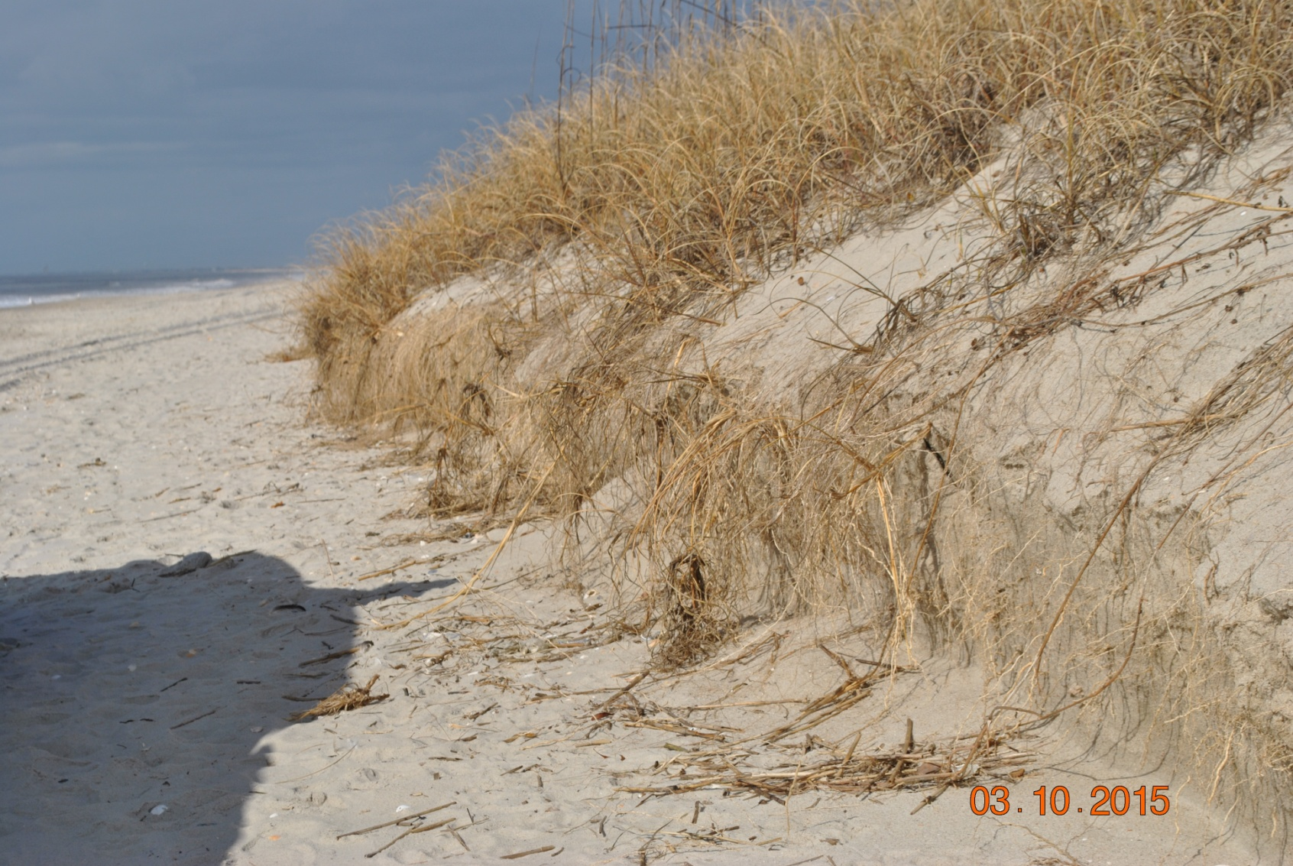
Stable Vegetation

Slide 4
Towns Current Policy
Currently the town uses, a natural stable vegetation line as established by our current CAMA LPO.
Other municipalities have a required Static Vegetation Line, based on regulatory requirements triggered by large scale beach nourishment Projects.
Triggered by 300,000 thousand cubic yards of fill

Slide 5
Based on our current policy of small beach nourishment projects we are not required to have a stable vegetation line..
The current policy has allowed us to increase buildable lot size.
But the policy limits us to small scale nourishment projects.

Slide 6
Static vegetation line limitation under current rules
If we were required to have a static vegetation line the following limitations would apply.
We could not recover lots after the vegetation line moves seaward.
There would be a 5 year waiting period after application.
After application is made there are limitations based on structure and lot size. (total floor area no greater than 2500 square feet)

Slide 7
#1Proposed CRC Changes
1. Allowing local governments to establish a Development line. That they establish and the CRC approves.
All development would be predicated off of that line.
General concept is that no new development and expansion of structures would be allowed seaward of the approved development line.
Effectively the graduated setback line becomes movable based on re approval of the development line.

Slide 8
#2 Proposed CRC Changes
Eliminate 2500 square feet maximum building size limit under the static line exception.
Eliminate the 5 year waiting period after an initial large beach fill project, ( making areas immediately eligible to partition for the exception)
Increase the existing 300,000 yards volumetric trigger for the static line as the definition of large scale beach fill projects.
Converts from 300,00 cubic yards to and average of 100 cubic yards per linear foot.

Slide 9
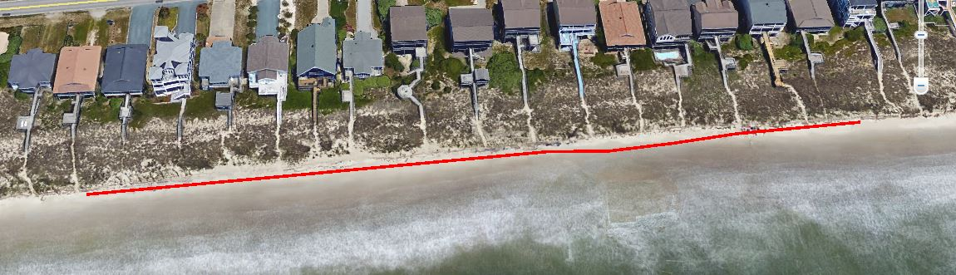

Slide 10
